Slide 1
Configure - Ansible
October 2022

Slide 2

What is Ansible?
“Ansible is a software tool that provides simple but powerful automation for cross-platform computer support. It is primarily intended for IT professionals, who use it for application deployment, updates on workstations and servers, cloud provisioning, configuration management, intra-service orchestration, and nearly anything a systems administrator does on a weekly or daily basis. Ansible doesn't depend on agent software and has no additional security infrastructure, so it's easy to deploy.”
Ansible documentation is great and has examples that can be leveraged
We are going to deploy:
Windows Domain Controller
Windows Member Server
Linux OpenVPN Server
Linux Web Server

Slide 3
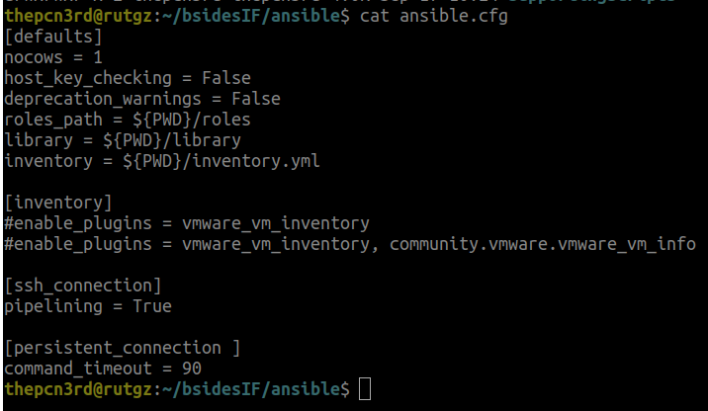
Ansible - ansible.cfg
nocows = 1 - Disables the ASCII Art Default Setting
host_key_checking = False (Poor Security)
deprecation_warnings = False (Poor Operational)
Inventory File
command_timeout - Necessary for slow connections or reboots in configurations

Slide 4
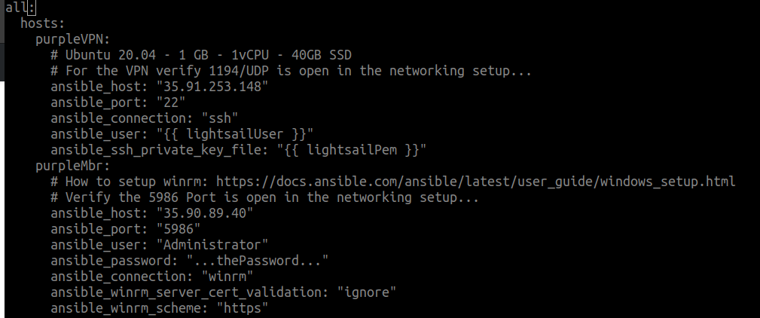
Ansible - inventory.yml (Inventory File)
Indentation is Important
Hosts (Associates to the Playbooks)
Ansible Connection
Ansible Variables

Slide 5
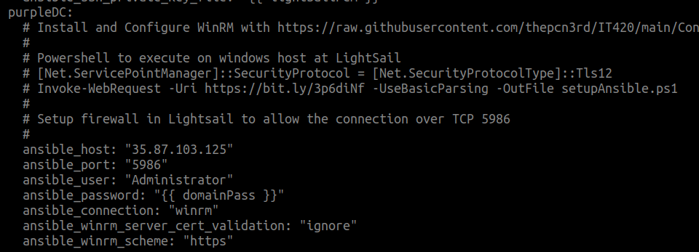
inventory.yml - Setup WinRM
Windows Ansible Setup
Powershell Script* Insecure
WinRM Setup Prior to Running Ansible Scripting

Slide 6
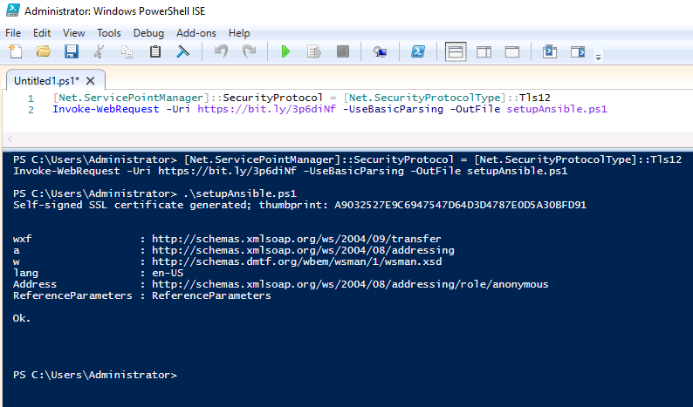
Setup of WinRM on purpleDC and purpleMbr
Type in the Powershell
Execute Powershell
Execute .\setupAnsible.ps1
Needs to be done prior to ansible executing the Windows Playbooks

Slide 7
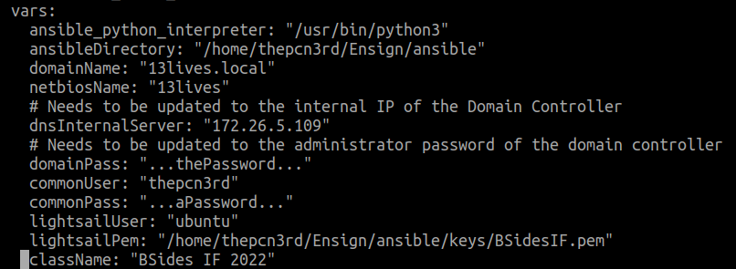
Inventory.yml - vars
Ansible Python Interpreter (When python2 was a thing…)
Variables used in playbook…
Change Paths as necessary
lightsailPem is what you download from your instance
dnsInternalServer is the Private IP of purpleDC, the domainPass is the administrator password of purpleDC, and the domainName and netbiosName used to create and join the domain present

Slide 8
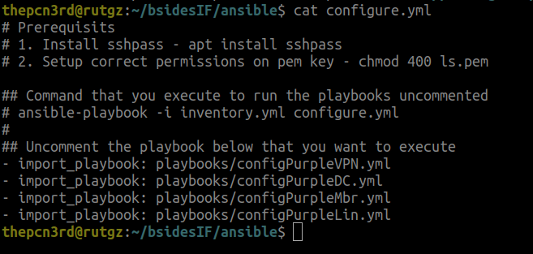
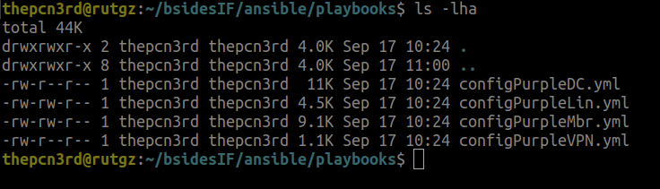
Configure.yml - playbooks.yml
Define in configure.yml the order to run the playbooks
Notes abort pre-reqs and how to execute with the inventory and configure files
Configure the DC before configuring clients that join to the DC
Defined a playbook for each server
Could define roles if I was configuring multiple servers as an apache webserver (Not demonstrated)

Slide 9
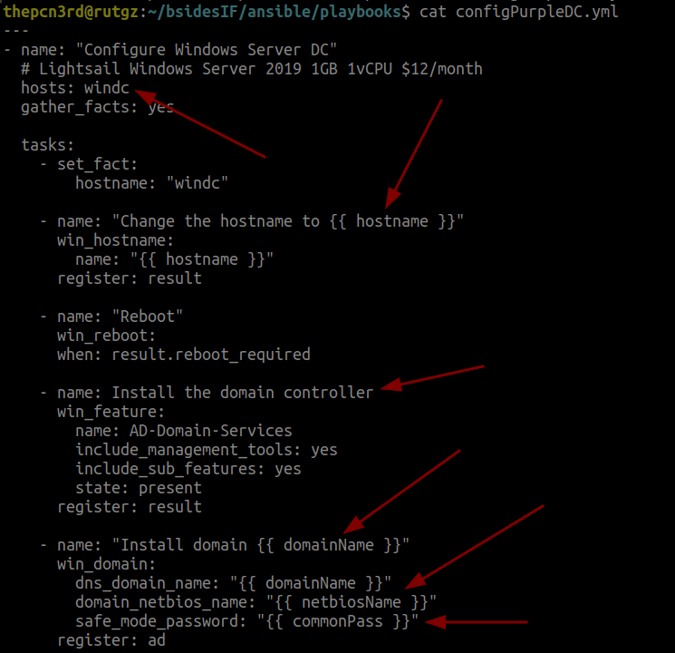
Playbook - configPurpleDC.yml
“hosts” - needs to match what is defined in inventory.yml to understand the IP, how to connect, how ansible connects, and passwords. This needs to be changed to purpleDC to match what is in the inventory.yml
Note the variables are pulled from the inventory.yml. The commonPass needs to be setup for the safe mode password of the domain.
Note the reboot, the ansible execution will wait until the reboot is completed. On a slow connection this can timeout.

Slide 10
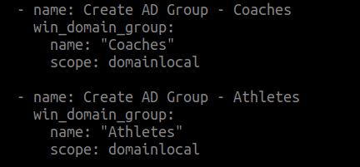
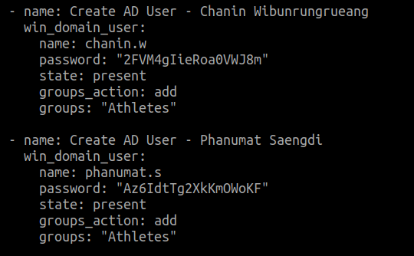
configPurpleDC.yml - AD Groups and Users
Configure AD Groups and Users
Setup the Group Scope
Assign the users to groups
Set the Password
*The password can we secured by methods provided by ansible that I have not done for the purposes of this lab.

Slide 11
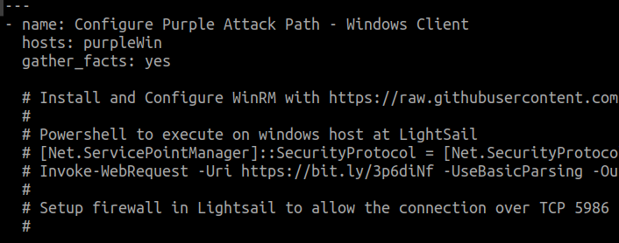
configPurpleMbr.yml - Prereq
“hosts” - Remember to set the hosts to match what is in the yml file
Note the pre-setup of ansible is necessary
Open in Lightsail the public port of TCP 5986 and filter based on your IP

Slide 12
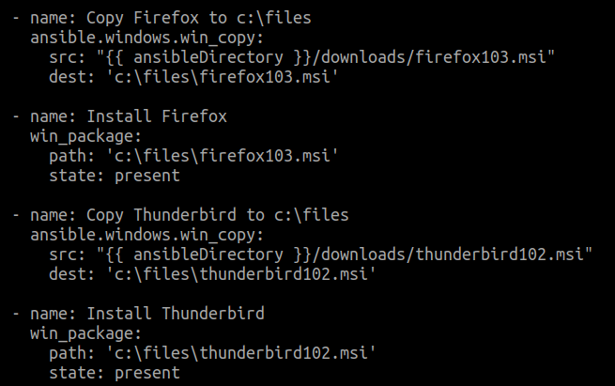
configPurpleMbr.yml - Install msi files
Copy program from ansible server to remote host
Install the MSI package, you can also remove
The path of c:\files is created above in the yml file
Everytime you execute this portion it will reinstall the msi file (You can change this behavior)

Slide 13
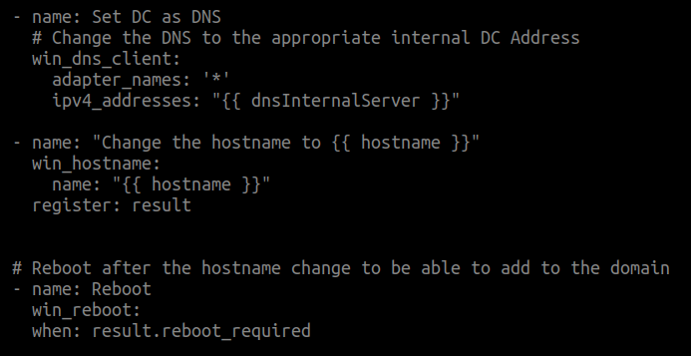
configPurpleMbr.yml - Configure to Join Domain
Setup the DNS of the server to use the private IP Address of the purpleDC
Change the hostname from the default one setup. I have defined the hostname in the top of this yml file
Then reboot for the settings to take effect…

Slide 14
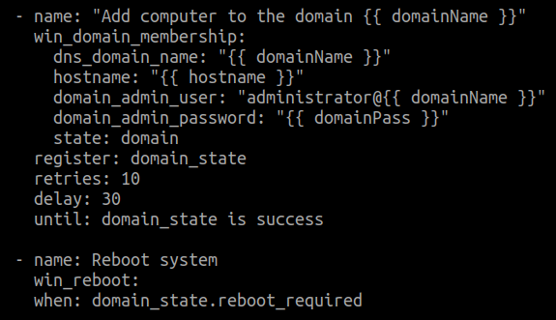
configPurpleMbr.yml - Join to Domain
Add the computer to the domain
Increase the delay if necessary
Reboot the System
With less than 50 lines of code we setup a domain controller, with users and groups, and joined a member server

Slide 15
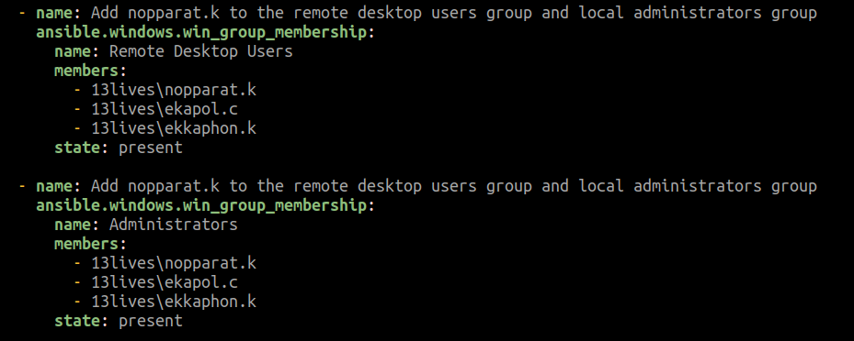
configPurpleMbr.yml - Define RDP Users
Based on domain users here are the accounts that are local administrators and remote desktop users

Slide 16
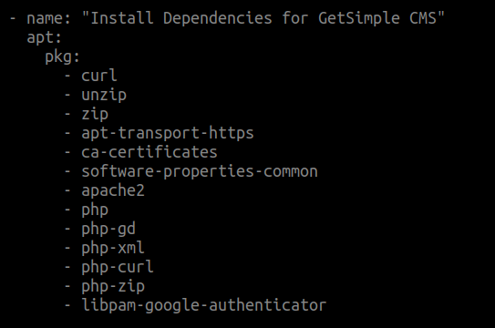
configPurpleLin.yml - Install Packages Ubuntu
This installs packages necessary for the webserver and php software
libpam-google-authenticator is necessary for the bypassing MFA technique

Slide 17
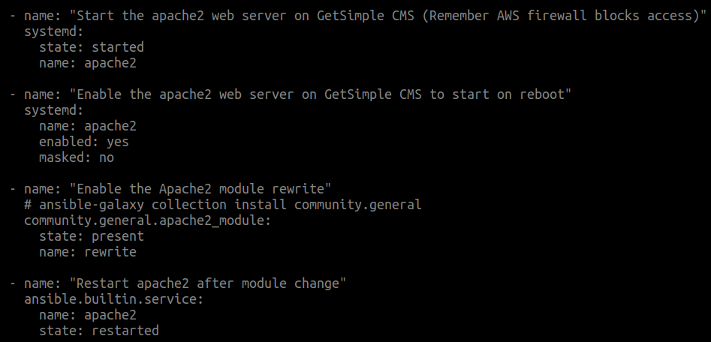
configPurpleLin.yml - Configure apache
Starts the apache server and enables it, in the event the server is restarted
Enables the mod_rewrite module for Apache
After the module is installed Apache needs to be restarted

Slide 18
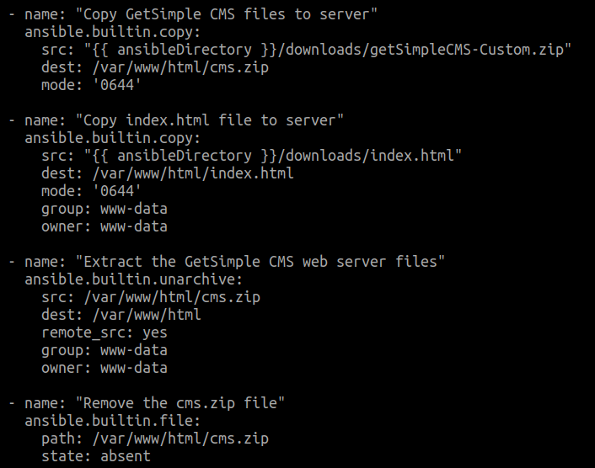
configPurpleLin.yml - Setup of GetSimple CMS
Pre-configured the GetSimple CMS PHP Website and created cms.zip
Copied the cms.zip and an index.html file to redirect to the cms folder where the CMS is located
Extracts the archive of cms.zip
Removes the archive of the cms.zip from /var/www/html (Good habit to remove zip archives)

Slide 19
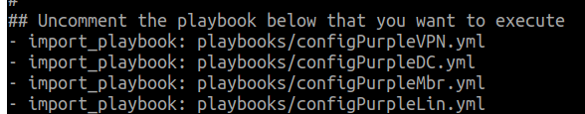

Configure.yml - Execution Order and Execution
In the configure.yml file is where the playbooks are referenced in the execution order that you need.
Then execute the command with the inventory and configure file. (If any errors re-execute)

Slide 20
Downloads and SupportingScripts Folder
Downloads folder contains msi packages, the software is now out-dated
Firefox
Thunderbird
OpenJDK 17 from Microsoft
Libre Office 7.35
“registrymodifications.xcu” - Used by Libre Office for Settings of Macros and History of Files
“pwshProcessODT.ps1 - Used by the scheduled task to execute the macros sent
7-Zip - Can be used in a dll persistence activity outside of Purple Attack Path
openvpn-install.sh - Script to configure openvpn
getSimpleCMS-Custom.zip - Customized working version of GetSimple CMS
SupportingScripts
buildADUsers.py - Used to generate the ansible yml to build the users, not the most efficient way of conducting this activity but was most efficient for what was created.

Slide 21
Keys Folder
Folder needs the SSH Key that is necessary to authenticate to your LightSail created Ubuntu Servers
Remember: You can create a custom key for the various instances of servers that you have…
The key if named something unique needs to be updated in the inventory.yml file for access to the Ubuntu Servers that you create

